Slide 1

LEAD CONVERSION Customer LEAD PREDICTION

Slide 2
PROBLEM STATEMENT
Too mach of null values.
Lot of unwanted columns.

Slide 3
TOOLS USED
Python
For data cleaning and EDA.
Power Bi
Creating Dash board.

Slide 4
APPROACHES
Data cleaning
EDA
Checking null values and fill the null values.
Drop some columns for more than 40% of null values.
Check and handle duplicate values.
Check and handle outliers
Univariate data analysis for value counts and distribution of variable.
Bivariate data analysis for correlation between variables.

Slide 5
EDA INSIGHTS
Overall conversion only 38.5%
Lead Origin: In landing page submission was highest conversion done 1786 out of 4886 leads. Least quick add form only 1 leads.
Lead Source: Google is the high conversion 1176 out of 2904 leads.
(31.4%).
Do not mail and Do not call: These two columns majority of peoples choose "no" option.
specialization: Most of peoples choose other option and followed by Finance Management is second highest 976.

Slide 6
EDA INSIGHTS
What is your current occupation: More than 90% of leads are unemployed. 2811 conversion
Do Not Email:92% of people choose "No". They want mail communication about course.
Converted: Only 38.5% of leads covert to customer and 61.5% of leads not converted to customer.
Total Visits, Total Time Spent on Website, Page Views Per Visit and Converted these correlation was good but these two columns converted and Page Views Per Visit correlation was negative.

Slide 7
CONCLUSION
Given data was very poor. Lot of empty values and unwanted columns.
Overall conversion only 38.5%, Conversion rate is low
Most of the leads comes from Google search and Direct traffic.
Focus on communication channels because most of the peoples want know about course details.
Unemployed people are our targeted customers.

Slide 8
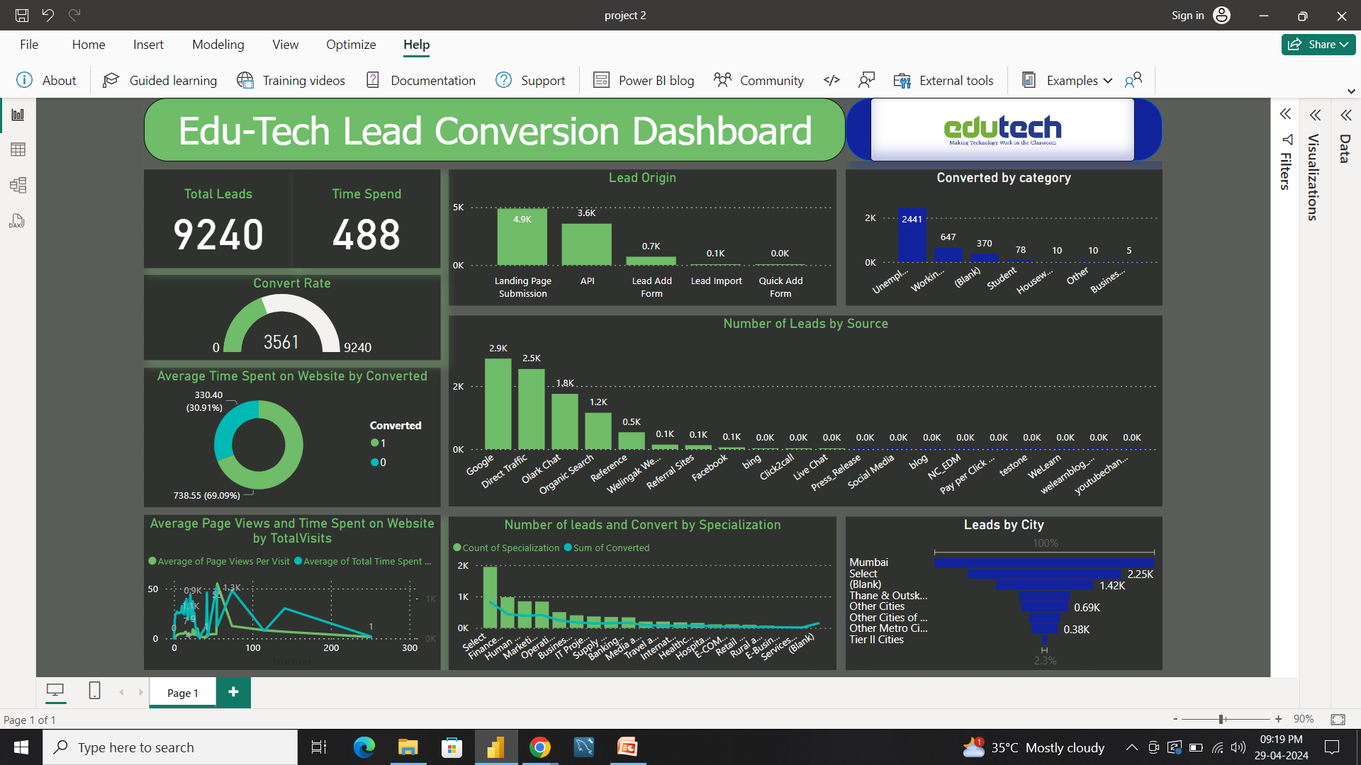
DASH BOARD

Slide 9
Google colab
https://colab.research.google.com/drive/12mz0NYzuQmxbCjJFCG334MS-qwl689YR?usp=sharing

